Slide 1
Junk-Broker System
Anthony Redamonti Michael Peña Clayton Colson Kenneth Chalupa

Slide 2
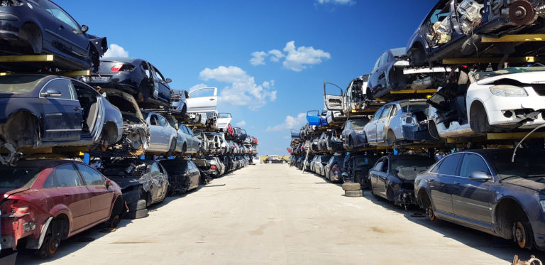
What is a Junkyard?
Yards that contain large quantities of scrap metal
Many specialize in storing nonfunctional or damaged vehicles, such as cars, trucks, SUV’s, motorcycles, boats, ATV’s, and other commercial types
Functional vehicular parts are sold at a discounted rate

Slide 3
What is the Junk-Broker System?
An interactive transaction-based application tailored toward the junkyard industry
Offers an easier method of buying and selling vehicular parts through an organized interactive application

Slide 4
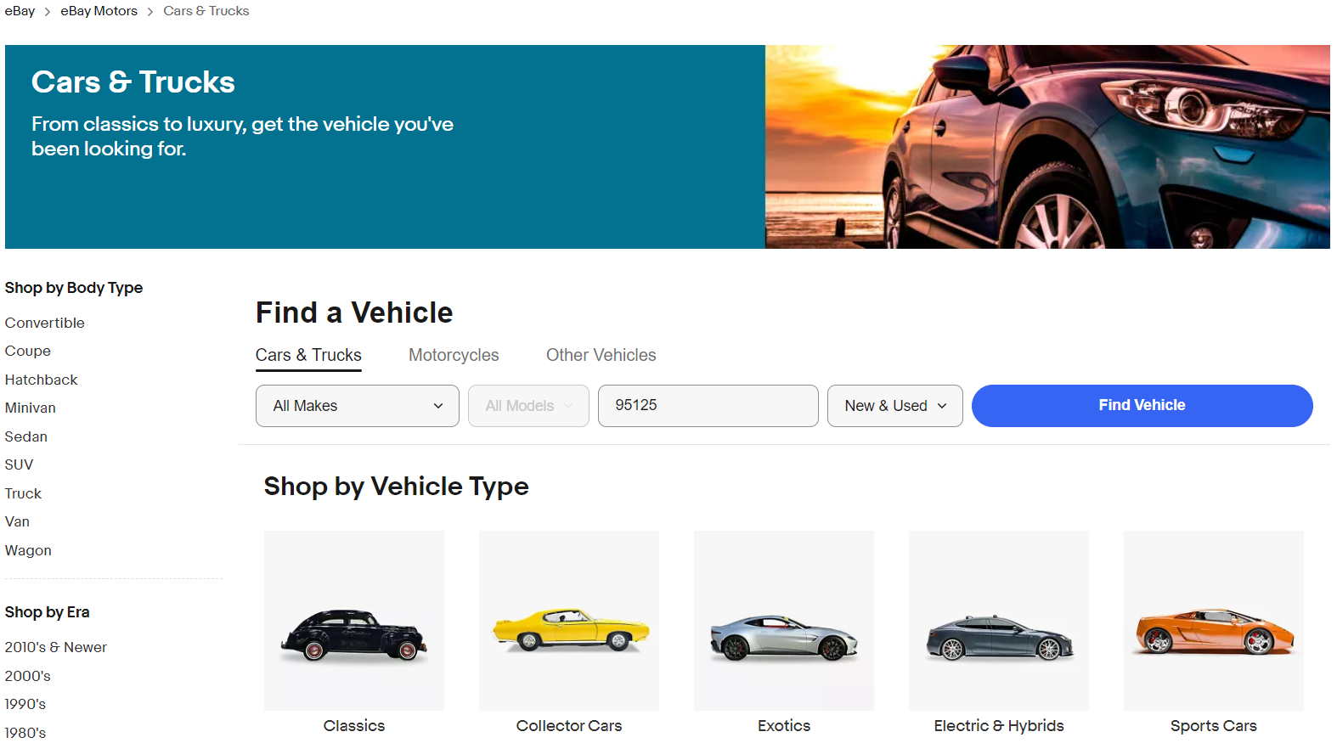
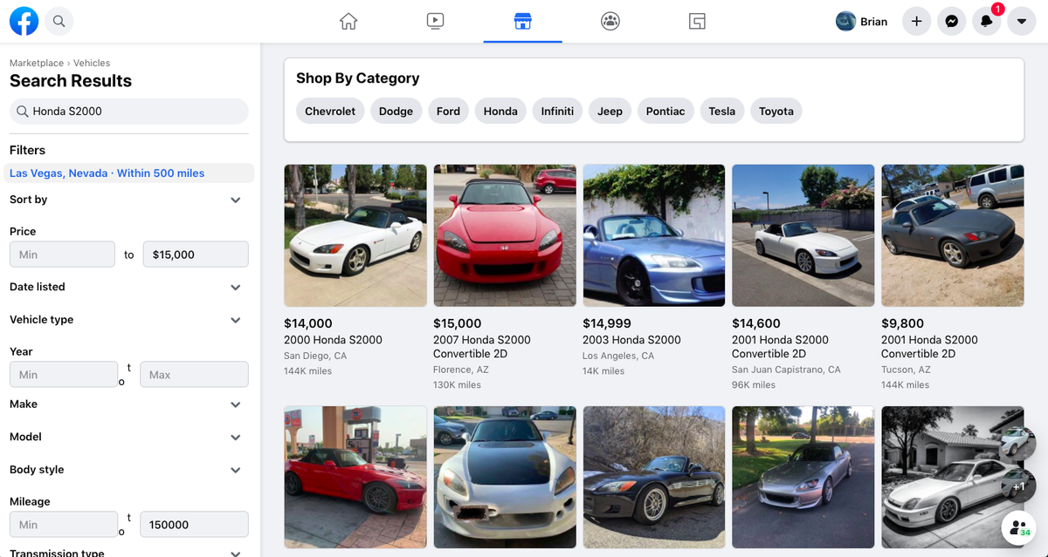
Similar Systems
Facebook Marketplace
Ebay

Slide 5
How the Junk-Broker System Operates
The seller uploads detailed listings of their inventory to their profile (UR6)
Buyers can search active listings and filter based on price, location, vehicle type, year, make, and model (UR3)
Buyers and sellers can send messages to each other (UR8), and purchases can be finalized through a third-party credit service (PayPal, Venmo, etc.) (UR14)
All profiles and listings are stored in a database hosted by several secure servers (UR15). The system is available at all times to buyers and sellers worldwide (UR16)

Slide 6
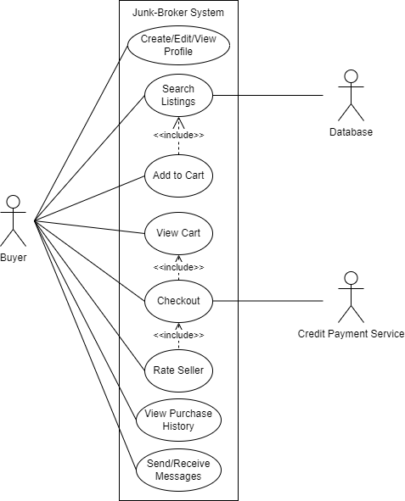
Use-Case Diagram: The Buyer

Slide 7
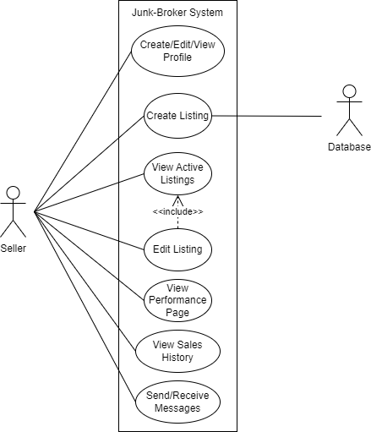
Use-Case Diagram: The Seller

Slide 8
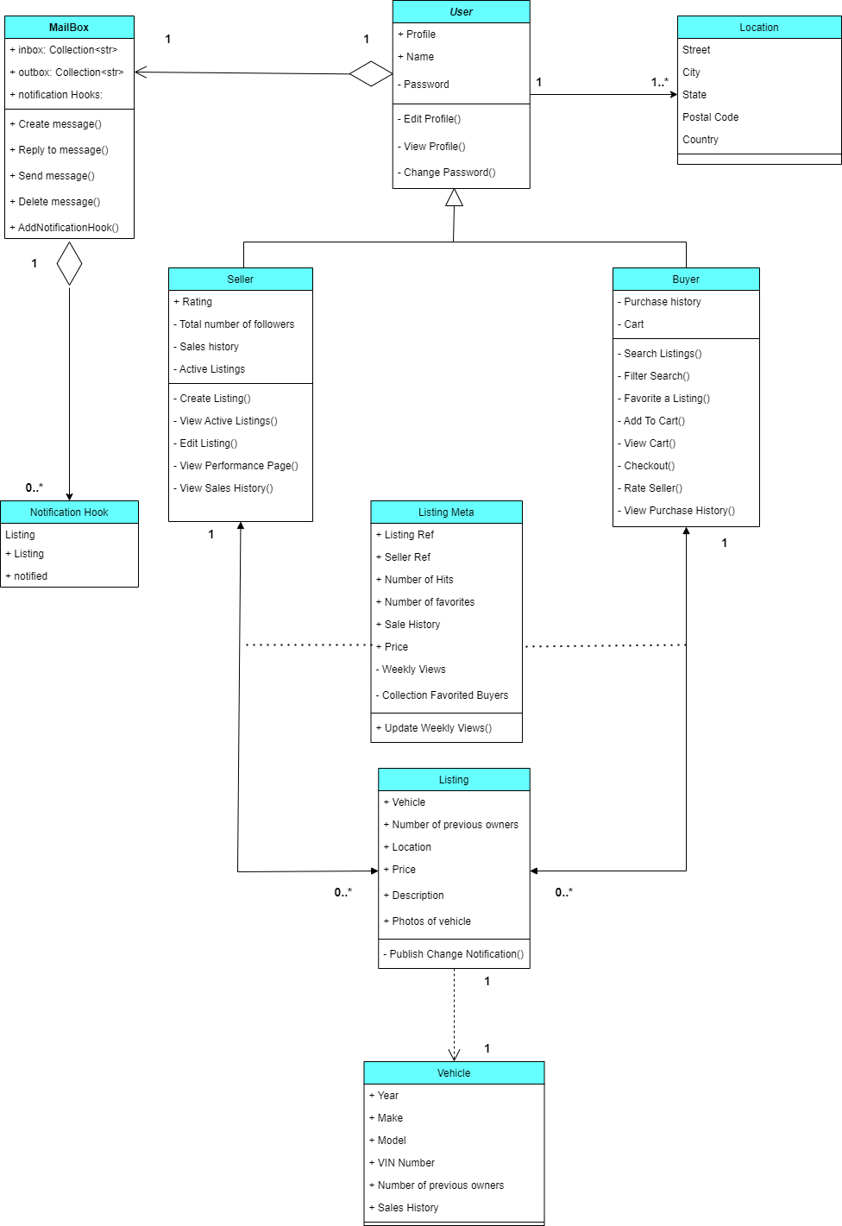
Class Diagram
Buyer and Seller classes inherit from User class
Seller composes listings
Seller writes to database
Buyer reads from database
Buyer and seller compose a mailbox to exchange messages
Note: Listings can be in multiple carts. Act fast, buyers!!

Slide 9
Priorities of User & System Requirements
Priority 1: Users access Junk-Broker System Web Browser or Mobile Device
UR4 -> SR4.1, SR4.2, SR4.3 (web page/mobile app available)
Priority 2: Allow Users to Create Account/Log-in as ‘Buyer’ or ‘Seller’
UR1 -> SR1 (users can create an account)
UR2 -> SR2.1, SR2.2, SR2.3 (users can login to account)
Priority 3: Allow Users to perform role specific functions within Junk-Broker
UR6 -> SR6.1, SR6.2, SR6.3 (sellers can create listings)
UR9 -> SR9.1, SR9.2 (sellers can edit listings)
UR3 -> SR3.1, SR3.2, SR3.3, SR3.4, SR3.5, SR3.6 (buyers can view/filter listings)
Priority 4: Transactions
UR14 -> SR12.1, SR12.2, SR13.1, SR13.2, SR14.1, SR14.2, SR14.3, SR14.4 (Sale of listed vehicles)
Priority 5: User to User interactions
UR8.1 -> SR8.1 (Transaction history available to users)
UR8.2 -> SR8.2, SR8.3 (Users can message other users)

Slide 10
Priorities of User & System Requirements
Priority 6: Metrics Collection and Notifications
UR7 -> SR7.1, SR7.2 (Buyers can access interest level metrics of listings)
UR10 -> SR10.1, SR10.2 (Users can mark listings as ‘Favorite’)
UR11 -> SR11.1, SR11.2, SR11.3 (Listing change notifications)
Priority 7: Availability and Accessibility
UR16 -> SR16.1, SR16.2, SR16.3, SR16.4 (Functionality must match increasing demand)
UR5 -> SR5.1, SR5.2, SR5.3, SR5.4, SR5.5 (W3c Web Accessibility Standards to user)

Slide 11
User Requirement 1: Account Creation
UR1. The Junk-Broker system shall allow anonymous users to create an account with the following roles to later be used securely:
• UR1.1: Buyer Role
• UR1.2: Seller Role

Slide 12
System Requirement 1: Account Creation
SR1: When a user creates an account in the Junk-Broker system, their information and role shall be securely stored in an encrypted database.

Slide 13
User Requirement 2: Buyer/Seller Actions
UR2. The Junk-Broker shall allow users to log-in, authorizing the option to perform ‘Buyer’ or ‘Seller’ specific role actions.

Slide 14
System Requirement 2: Buyer/Seller Actions
SR2.1: A unique user Id shall be mappable to the user’s information and role
SR2.2: Users shall not have the ability to change their roles or have any access to their role assignment
SR2.3: Each user shall be only allowed 1 role assignment: either ‘Buyer’ or ‘Seller’

Slide 15
User Requirement 3: Filtering the Search
UR3. The system shall include filters that the buyers can use to filter merchandise from multiple sellers. The filters shall be as follows:
Price
Location
Vehicle Type
Make
Model
Year

Slide 16
System Requirement 3: Filtering the Search
SR3.1: By default when no filters are selected, the listings should be sorted by location within 20 miles of the buyer
SR3.2: There shall be a filter feature, that when activated, provides accessibility to all the filters described in UR3.
SR3.2.1: The settings for each filter shall be accessible from the filter feature
SR3.2.2: The filter feature shall have the ability to clear all filters in use and the ability to apply the filters to the listings
SR3.2.3: The feature shall also allow the user to return to viewing active listings
SR3.3: Each filter setting in the filter feature shall have three features:
SR3.3.1: The ability to return to the main filter feature without saving the changes to the filter
SR3.3.2: The ability to reset the specified filter setting
SR3.3.3: The ability to save the specified filter setting

Slide 17
System Requirement 3: Filtering the Search (continued)
SR3.4: The vehicle type filter setting shall allow the user to select one or more of the following vehicle type options:
Cars
Trucks
SUV’s
Sedans
Vans
Motorcycles
Boats
Commercial Vehicles
ATV’s
Bicycles
There will also be an option “any” to select all of these vehicle types

Slide 18
System Requirement 3: Filtering the Search (continued)
SR3.5: The price filter setting shall prompt the user to enter the minimum and maximum values of the search
SR3.5.1: The user shall not be able to enter a minimum or maximum price less than zero
SR3.5.2: The user shall not be able to enter a minimum price greater than the maximum price or a maximum price less than the minimum price
SR3.6: The location filter setting shall prompt the user to enter a zip code and a search radius in miles originating from the zip code in which to search
SR3.6.1: The user shall not be able to enter an unknown or improperly formatted zip code
SR3.6.2: The user shall not be able to enter a search radius less than zero miles

Slide 19
System Requirement 3: Filtering the Search (continued)
SR3.7: The Make filter feature shall provide the user with the ability to choose one or more vehicle makes listed among the top 25 most popular vehicle make types. There will also be an option “any” to select all make types
SR3.8: The Model filter feature shall provide the user with the ability to choose from all models offered by the vehicle manufacturers selected in the Make filter feature. The user must select at least one vehicle manufacturer in the Make filter feature before using the Model filter feature
There will also be an option “any” to select all Model types
SR3.9: The Year filter feature shall prompt the user to enter the minimum and maximum years between which the manufacturing date is specified
SR3.9.1: The user shall not be able to enter a minimum or maximum year less than zero
SR3.9.2: The user shall not be able to enter a minimum year greater than the maximum year or a maximum year less than the minimum year

Slide 20
User Requirement 4: Accessibility
UR4. The junk-broker system shall be accessible from the most common browsers and devices

Slide 21
System Requirement 4: Accessibility
SR4.1: The junk-broker front-end Graphical User Interface (GUI) will be optimized for the platform rendering it (desktop / mobile)
SR4.2: The desktop view will be the primary means of control and interaction
SR4.3: Mobile will make use of orientation and have a reduced but specific feature set

Slide 22
User Requirement 5: Standards
UR5. The junk-broker system shall follow industry-based design standards and guidelines

Slide 23
System Requirement 5: Standards
SR5.1: The junk-broker front-end GUI shall incorporate W3C’s Web Accessibility Initiative - Web Content Accessibility Guidelines (WCAG) design principles
SR5.2: The GUI will be perceivable:
5.2.1: Non-text buttons/controls will be named according to their purpose
5.2.2: The GUI will present content in different ways without losing information or structure
5.2.3: The GUI will be distinguishable, making it easier for users to see by including appropriate use of color and contrast, or differentiating between foreground and background tasks

Slide 24
System Requirement 5: Standards (continued)
SR5.3: The GUI will be operable
5.3.1: All functionality will incorporate text input controls and provide functionality beyond standard keyboard input
5.3.2: Time-dependent features will be adjustable
5.3.3: Content will not be designed in a way that is known to cause seizures or physical reactions
5.3.4: The GUI will provide users clear ways to navigate, find content, and determine their current location
SR5.4: The GUI will be understandable
5.4.1: Content will be readable and predictable
5.4.2: Input fields will provide assistance and suggestions
SR5.5: The GUI will conform to Level A standards of the WCAG 2.1 standard

Slide 25
User Requirement 6: Creating a Listing
UR6. Sellers shall be able to create a listing after providing the following required information regarding the listing:
Vehicle Type
Year
Make
Model
Number of previous owners
Location
Price
Description
Photos of vehicle
The system may present the seller with optional fields to append to the new listing. The optional fields are related to personal contact information and are as follows:
Email Address
Phone Number

Slide 26
System Requirement 6: Creating a Listing
SR6.1: The system will not allow the user to create a listing without populating all the fields specified in UR6 with a valid entry. If the user attempts to create a listing that is missing information from one or more of these fields, an error message will be displayed specifying the fields that require attention
SR6.2: The system shall immediately upload all images and related listing content to the database upon the creation of a listing
SR6.3: The system shall not allow the entry of invalid data into a given field. Examples of invalid data include improper formatting of a phone number or email address or uploading unsupported file formats into the photos section

Slide 27
User Requirement 7: Seller’s Performance Page
UR7. The system shall provide a performance page that is private to the seller. It shall include the following features:
UR7.1: The seller shall be able to see his performance rating given by the sellers. The scale shall be from zero to five stars in half star increments
UR7.2: The seller shall be able to see the total number of followers of their profile
UR7.3: The total number of views for each listing in the past seven days shall be shown

Slide 28
System Requirements 7: Seller’s Performance Page
SR7.1: The buyer shall be able to rate a seller only after purchasing an item from the seller
SR7.2: In addition to being displayed on the seller’s private performance page, the average rating shall be publicly displayed on the seller’s profile for buyers to review

Slide 29
User Requirement 8: Transaction History and Messaging
UR8. The system shall provide the following private features on the profiles of both the buyer and seller:
UR8.1: A complete transaction history
UR8.2: A messaging feature of received and sent messages

Slide 30
System Requirement 8: Transaction History and Messaging
SR8.1: All messages and transactional data shall be stored in the junk-broker database. Only listings that are sold shall be considered transactional history
SR8.2: The messaging feature shall include an inbox/outbox that utilizes Simple Mail Transfer Protocol (SMTP)
SR8.3: The messaging feature shall include functionality to create a new message, send a message, respond to an existing message, and delete selected message(s)

Slide 31
User Requirement 9: Active Listings
UR9. All active listings shall be presented to the seller. The seller shall be able to edit and change the status of active listings

Slide 32
System Requirement 9: Active Listings
SR9.1: Editing an existing listing is subject to the same requirements specified in SR6.1, SR6.2, and SR6.3
SR9.2: When the status of a listing is marked as missing, stolen, or sold, or if the listing is deleted by the seller, it will be removed from the active listings viewer

Slide 33
User Requirement 10: Favorite Listings
UR10: A user shall be able to mark a listing as a ‘favorite’ that will produce a list for them to view at all items

Slide 34
System Requirements 10: Favorite Listings
SR10.1: The system shall prompt a button for a user to mark a listing as a favorite
SR10.2: Each listing a user marks as a ‘favorite’ will be added to a list of a users favorite listings collection for further use and metrics

Slide 35
User Requirement 11: Favorites Notifications
UR11: A user shall receive notifications of the status change, price change, or any change in a vehicle they have marked as ‘favorite’

Slide 36
System Requirements Specification 11: Favorites Notifications
SR 11.1: Each favorited listing will register a hook that will trigger upon any listing change
SR 11.2: The changed status of the listing will sent to the potential buyer’s mailbox
SR 11.3: Use of any basic pub/sub framework (such as Kafka, Redis Message Broker, Azure Service-Bus) can publish the listing state change events to all buyers/subscribers who ‘favorited’ that listing

Slide 37
User Requirements 12: Order Status
UR12: A user shall be able to track the shipping status of the order.
UR12.1: The system shall display the current tracking information to the user.
UR12.2: The system shall notify the user to any changes or delays to the order status

Slide 38
System Requirements 12: Invoice Confirmation
SR12.1: The system shall present a final detailed invoice to the current order once it is confirmed by the user.
SR12.2: The system shall provide the option to send the invoice to the user’s profile email.

Slide 39
User Requirements 13: Search Function
UR13: A user shall be able to enter search text on the screen.
UR13.1: A user shall be able to enter multiple keywords in the search text.
UR13.2: The system shall return results matching the keywords entered by the user.
UR13.3: The system shall limit the matching results displayed on the screen to a default value of 10 results.
UR13.3.1: The user shall be able to increase the number of matching results displayed on the screen to 50 results.
UR13.4: The system shall notify the user when no matching product is found based on the user’s search.

Slide 40
System Requirements 13: Shopping Cart
SR13.1: The system shall provide a shopping cart to facilitate online purchases.
SR13.2: The system shall allow the user to edit the shopping cart by adding or removing products located in the user’s specific shopping cart instance.

Slide 41
User Requirements 14: Open Orders
UR14: A buyer shall be able to add an item to a cart and initiate a Point of Sale of item on listing

Slide 42
System Requirements 14: Open Orders
SR14.1: The system shall display current open orders that are available to change.
SR14.2: The system shall allow the user to select an order to be changed.
SR14.3: The system shall provide an option to cancel an open order.
SR14.4: The system shall notify the user about any changes that have been made to the order.

Slide 43
User Requirements 15: Security
UR15: The junk-broker database shall securely store customers’ private data

Slide 44
System Requirement 15: Security
SR1.1: The junk-broker database shall use a secure server that uses a Firewall to protect against attackers. Customers and sellers will rely on the security of the server to protect their private information in the database
SR1.2: All network traffic shall be encrypted to prevent hijacking and injection attacks
SR1.3: If a data breach is detected, the following events will take place:
Log-in’s, passwords, and PIN’s are secured
The sensitive data that was stolen is identified
A claim is filed with the Federal Trade Commision
All buyers and sellers are notified of the breach via email

Slide 45
User Requirement 16: Availability
UR16. The junk-broker system shall be available to customers at all times

Slide 46
System Requirement 16: Availability
SR16.1: The junk-broker database shall also be hosted on a backup server in case the main server goes offline. If the main server crashes, the backup server shall be used to keep the database online while the main server is under repair
SR16.2: The maximum allowable system downtime shall not exceed 1 hour
SR16.3: The backup server shall be housed in a secure and separate location than the main server

Slide 47
System Requirement 16: Availability (continued)
SR16.4: In case of large amounts of pending requests, the main server shall offload a percentage of its workload to the backup server to maintain system responsiveness. The percentage shall be calculated based on the number of pending requests and the resources available to the main server
SR16.5: Use of Container-Orchestration Services such as (Kubernetes, Rancher etc.) can be utilized to scale backend services to provide elastic scaling to match increasing or decreasing demand

Slide 48

Thank you!

